Slide 1


QUANTITATIVE MARKET DASHBOARD
Microsoft Analytics Engine
Quantitative risk evaluation, market trajectory, and benchmark alpha analysis for MSFT from January 2021 to Present.
STACK
TIMEFRAME
SYMBOL
Streamlit · Plotly · yFinance
Jan 2021 — Oct 2026
NASDAQ: MSFT

Slide 2
KEY PERFORMANCE INDICATORS
Market Returns & Risk Metrics
CURRENT PRICE
PERIOD RETURN
ANNUAL VOLATILITY
SHARPE RATIO
$532.95
156.8%
27.2%
0.67
Spot market price (Oct 2026)
Cumulative gain since Jan 2021
Annualized daily standard deviation
Risk-adjusted excess return
Max Historical Drawdown (-37.1%)
FULL RECOVERY
Moderate tech-sector compression in late 2022 before the Copilot & Azure AI expansion.

Slide 3



SOFTWARE ENGINEERING
Dashboard Technical Architecture
yFinance Data Engine
Pandas Vector Calculations
Plotly Dark Visualizations
Downloads split-adjusted closing prices for MSFT and ^GSPC with MultiIndex column normalization.
Computes 50-day / 200-day rolling moving averages, annualized volatility (27.2%), and cumulative drawdowns.
Renders dark-themed line charts, histograms, and shaded drawdown plots using Microsoft brand colors.

Slide 4
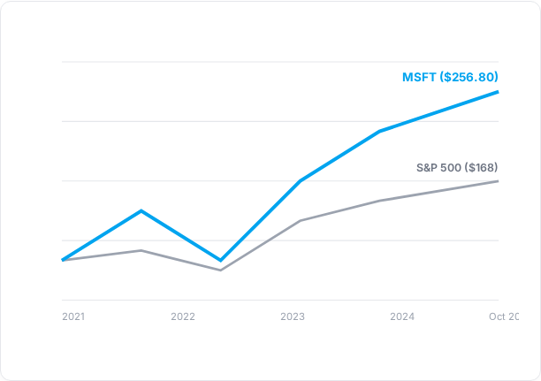
BENCHMARK COMPARISON
Growth of $100 Invested vs S&P 500
Outperformance
Grew $100 into $256.80 compared to $168 for the broader S&P 500 benchmark.
Moderate Beta Growth
27.2% volatility offers steady growth with lower drawdown severity than hyper-beta AI hardware plays.
Cloud & Copilot Catalyst
Azure AI and Office 365 Copilot integration provided compounding revenue momentum.

Slide 5

CORE BUSINESS DRIVER
Cloud & Enterprise AI Platform
Microsoft's transformation into an AI cloud powerhouse underpins its sustained long-term valuation gains.
01
Azure AI Scaling
Enterprise cloud platform hosting major LLMs and custom enterprise AI workflows.
02
SaaS Monetization
Copilot subscriptions adding recurring ARR across commercial Microsoft 365 suites.

Slide 6
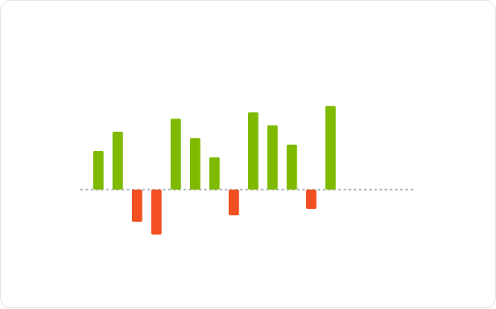
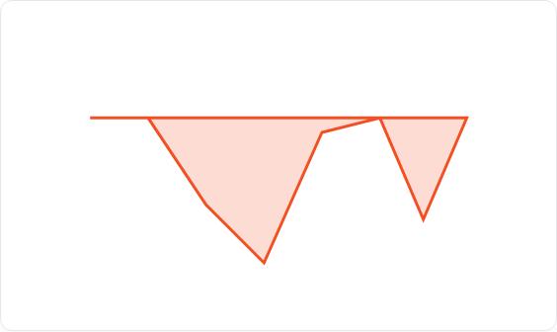
RETURN & RISK DISTRIBUTION
Volatility Profile & Drawdown Mechanics
Monthly Return Bars
Max Drawdown Area (-37.1%)
Green (#7FBA00) indicates positive months; Red (#F25022) indicates monthly declines.
Filled red area highlighting percentage loss from historical peak value.

Slide 7

Microsoft Analytics Dashboard
Run locally via VS Code terminal using streamlit run msft_app.py.
Questions & Architecture Discussion

Slide 8

Image Sources
https://images.stockcake.com/public/9/5/9/95956309-7eb3-4c51-9f92-493a0c79f423_large/data-center-glow-stockcake.jpg
Source: stockcake.com

